Slide 1
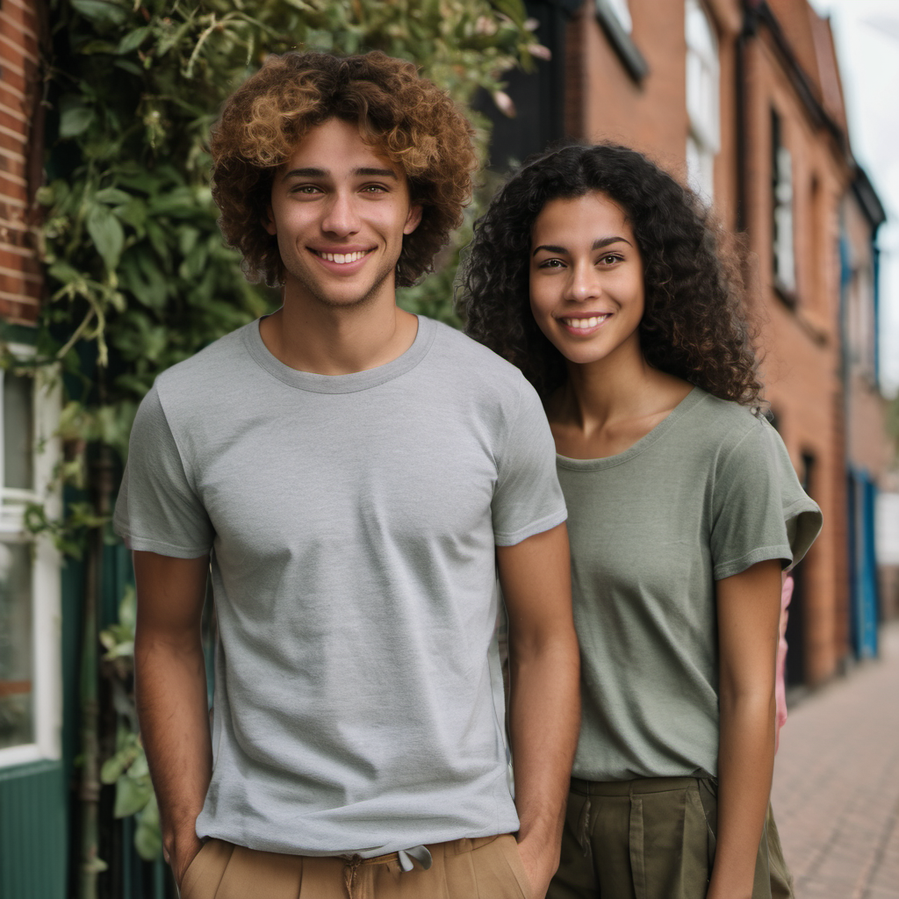
Urban Heat
Make room for nature
A 30-second climate-awareness film
Opening demo: play the film
SDG 13: Climate Action / AI-generated fictional scenes
Notes:
Timing: 40 seconds including the film. Introduce the title, then play urban-heat.mp4 in the video player. The supplied film lasts 30.42 seconds. Return to the deck after playback. The movie is provided alongside the deck, not embedded. The image is an AI-generated fictional scene supplied by the team.

Slide 2
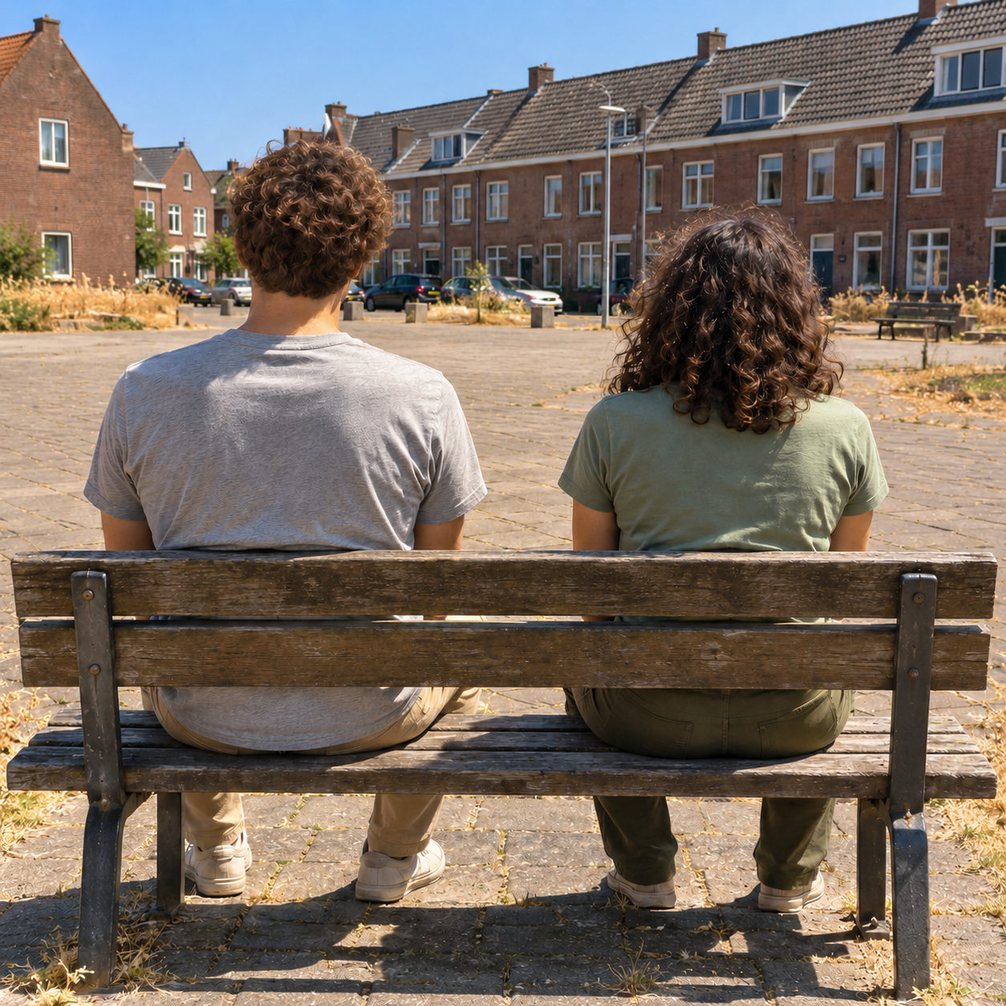
Urban heat in everyday spaces
Paving and buildings store heat.
Shade changes how an outdoor space feels.
KNMI reports city–countryside differences of up to 7°C for a city of 200,000 people, during clear, calm nights.
The film illustrates a daytime experience. It does not measure temperature.
Notes:
Timing: 50 seconds. Explain that our story takes place in a fictional Dutch neighbourhood on a hot summer day. KNMI states that city–countryside temperature differences can reach 4°C for a city of 10,000 inhabitants and 7°C for a city of 200,000 inhabitants. These large differences occur on clear, calm nights. They are not a measured difference between our daytime benches. EPA explains the cooling roles of shade and evapotranspiration. Sources: https://www.knmi.nl/kennis-en-datacentrum/uitleg/stadsklimaat and https://www.epa.gov/heatislands/benefits-trees-and-vegetation . Starting image supplied by the team.

Slide 3
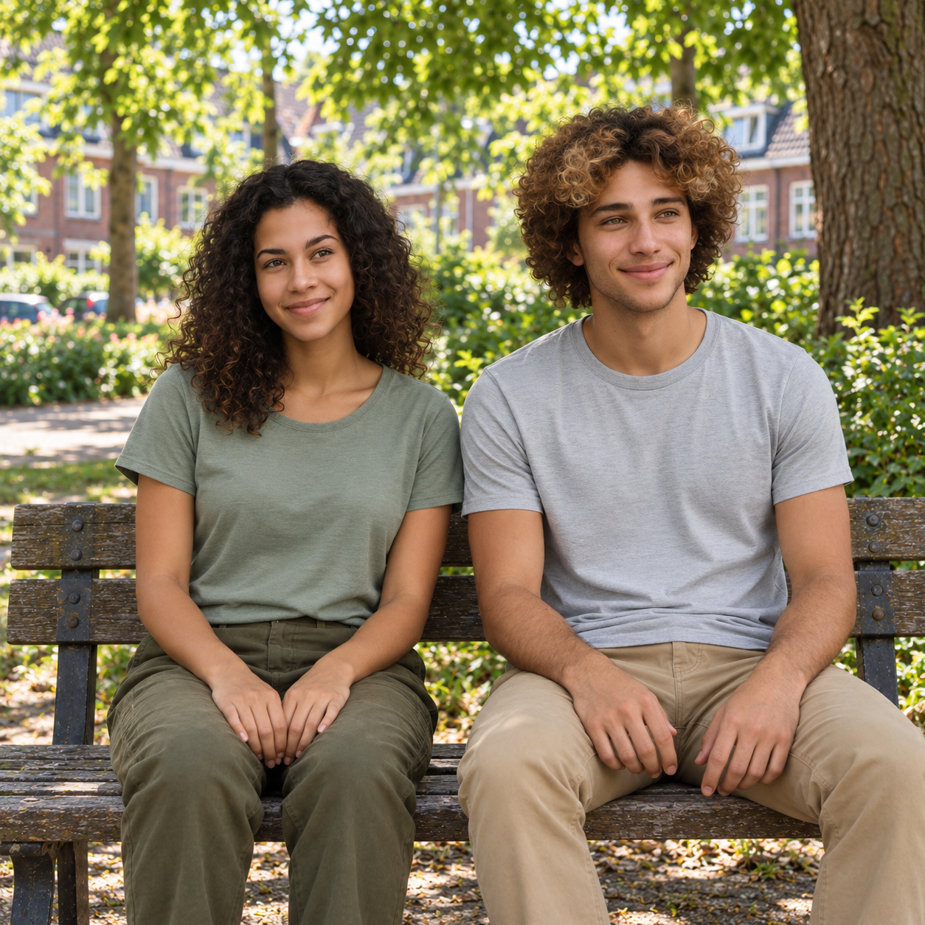
Our audience
Students aged 18–25
in Dutch cities
Context
Walking between classes, transport and home
Placement
A student association’s Instagram feed
Specialist planning and personal health advice fall outside this film’s scope.
Notes:
Timing: 45 seconds. The intended audience is students aged about 18–25 in Dutch cities, especially those walking between classes, public transport and home. We chose a student-association Instagram feed as the intended placement, with YouTube as the portfolio copy. Familiarity with heat but limited attention to street design is a design assumption, not audience research. The film does not meet the needs of professional planners or people seeking personalised health advice. Its mobile young protagonists do not represent everyone affected by heat. Image supplied by the team.

Slide 4
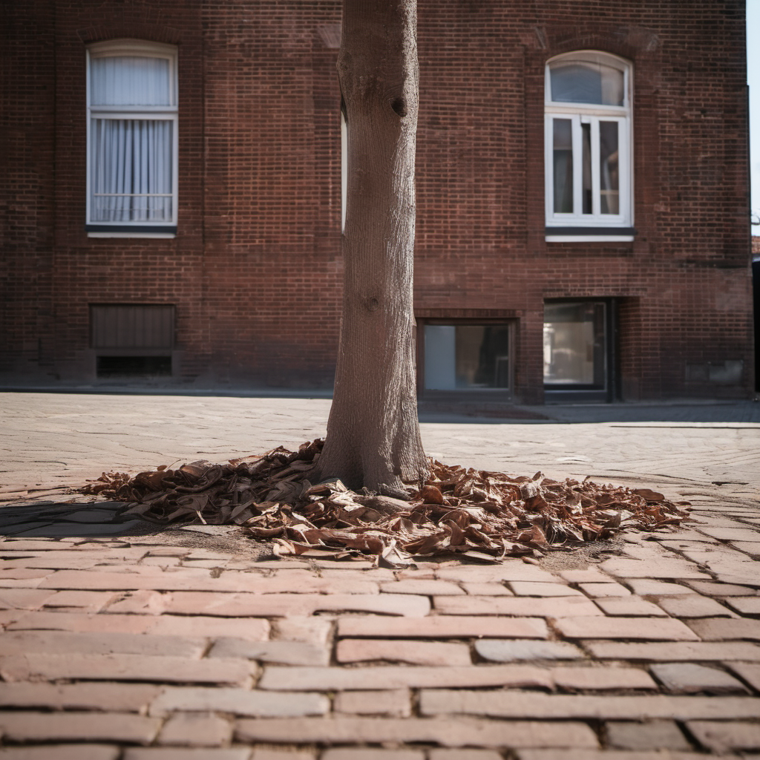
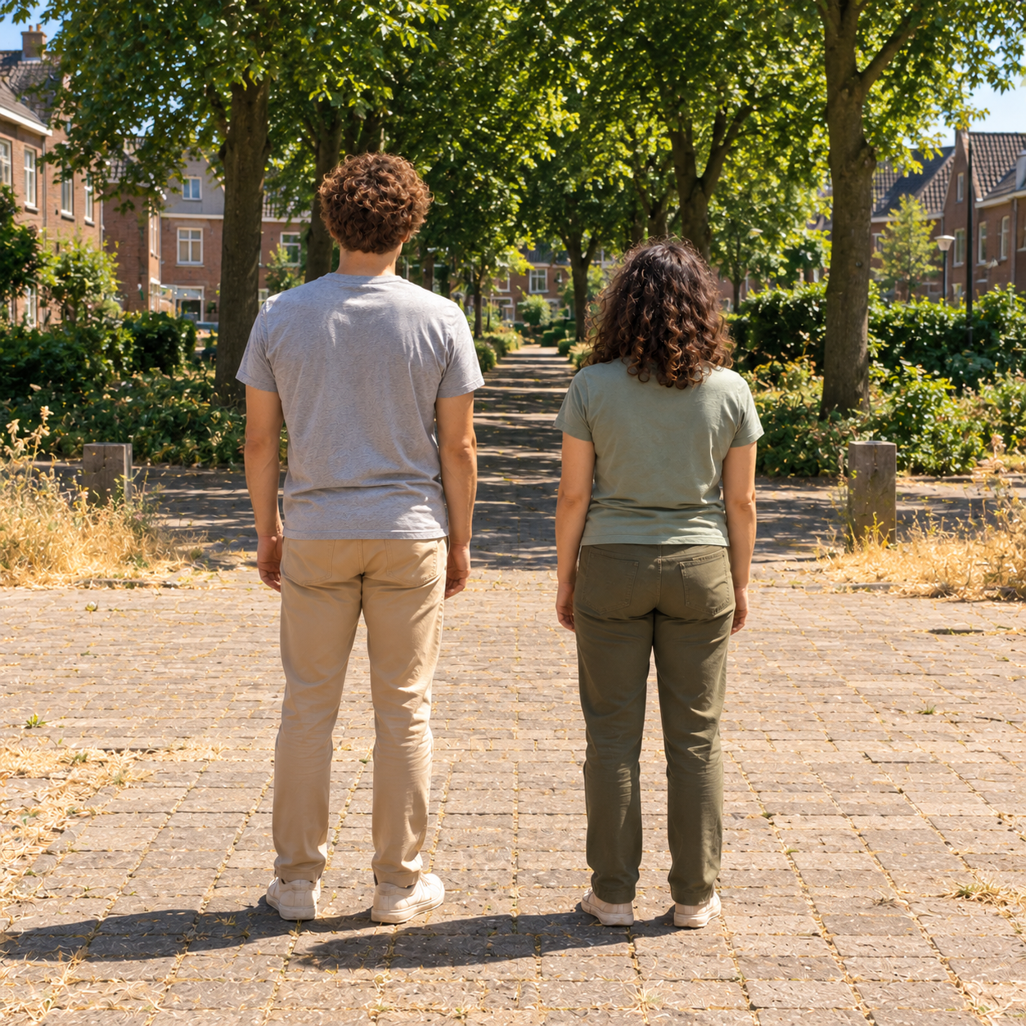
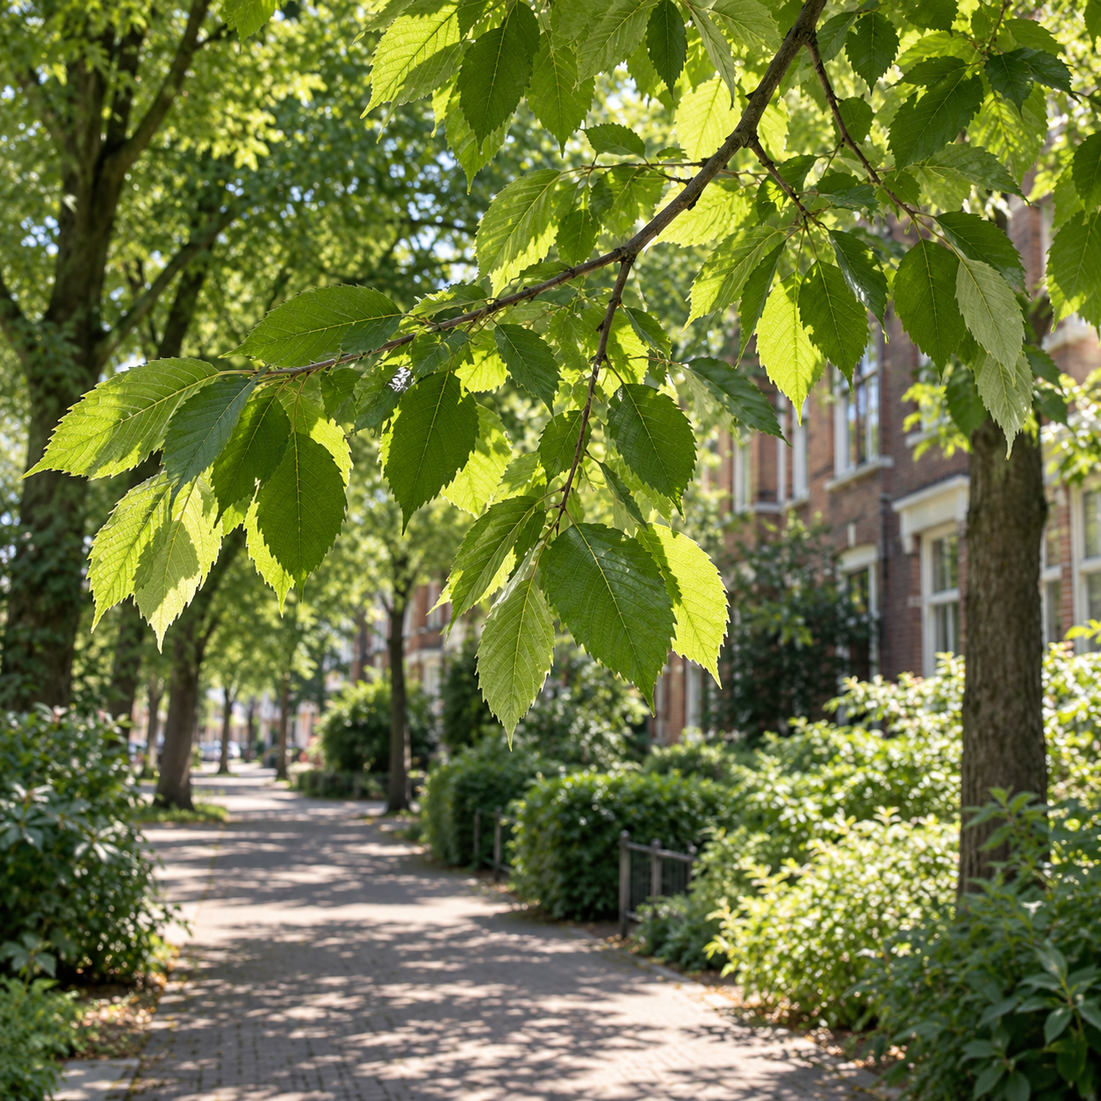
The six-shot story
01–03 Exposure
04 Movement
05–06 Relief
Six shots, approximately five seconds each
Notes:
Timing: 45 seconds. Describe the sequence: students walk through the neighbourhood, leaves move in the paved street, the students feel uncomfortable on a sunlit bench, they walk toward shade, we see green leaves, and they relax on a shaded bench. Shots last roughly five seconds. The same clothes and hairstyles support continuity. The three images on this slide are supplied starting frames for shots 2, 4 and 5. Dry leaves are a storytelling cue, not evidence of climate change.

Slide 5
The ComfyUI workflow
INPUT
GENERATION
OUTPUT
Starting frame
Motion prompt
Negative prompt
Saved settings
Wan 2.2 TI2V 5B
KSampler
VAE decoding
Animated clip
Film editing
Final MP4
ComfyUI generates the motion. The editor assembles the six clips.
Notes:
Timing: 65 seconds. Inputs are a starting frame, a motion prompt, a negative prompt and saved settings. Load Image provides the composition. The CLIP text encoder encodes prompts. Wan22ImageToVideoLatent prepares the sequence. Wan 2.2 and KSampler generate motion. The VAE decoder converts latent samples to visible frames. Create Video and Save Video produce the clip. Editing the six clips and adding sound is a separate manual production step. Working settings: 768×768, 121 frames, 24 fps, batch 1, 30 steps, CFG 4, uni_pc, simple scheduler, denoise 1 and shift 8. Final per-shot exports and seeds still need archiving. Official workflow reference: https://docs.comfy.org/tutorials/video/wan/wan2_2

Slide 6
What we learned
Specific actions made motion clearer
“Take alternating steps” gave the model a more concrete task than “walk naturally”.
Stable inputs helped character continuity
Hair, clothing and composition needed to stay consistent across shots.
Longer renders did not guarantee better results
We still needed to inspect blur, faces, movement and distorted textures.
Notes:
Timing: 55 seconds. Explain the actual iteration problems: static-looking shots, facial distortion, inconsistent characters, memory limits and decoding artefacts. Action-specific prompts were more useful than scene descriptions alone. Changing seeds changed results, but a seed alone did not guarantee quality. We adjusted tile sizes while troubleshooting but did not isolate every cause. Some long renders still looked poor. A reported render took about an hour. The practical lesson is to save a successful workflow and review the output rather than assuming more compute guarantees improvement.

Slide 7
Ethical choices and remaining work
Risk: realistic fiction can look like evidence
Our story avoids named locations and measured temperature claims.
Remaining safeguard
A readable AI disclosure inside the film, plus matching captions.
Computing cost
Repeated renders used GPU time. Energy use and total generations remain unmeasured.
Notes:
Timing: 60 seconds. Photorealistic climate imagery could mislead viewers into treating fictional scenes as documentation. We avoided named places and exact temperature claims within the story. No real person was intentionally depicted. A visible disclosure inside the film still needs confirmation or implementation. This presentation's disclosure does not substitute for the film safeguard. Multiple generations used GPU resources; we do not have an energy measurement or complete generation count. We should record an honest estimate from logs. A related assignment constraint remains: some starting images came from another generator, which conflicts with the all-ComfyUI rule unless the teacher grants an exception. Do not claim that all visuals originated in ComfyUI.

Slide 8
Climate awareness and next steps
SDG 13.3
Awareness of climate adaptation
Intended message
Greener public spaces can offer relief from urban heat.
Next test
Do students understand the message and recognise the imagery as fictional?
Notes:
Timing: 45 seconds. Target 13.3 concerns education and awareness of climate mitigation, adaptation and impact reduction. Our contribution is a short awareness film about urban heat and greenery. We have not measured changes in understanding or behaviour. A useful next test would ask students what they took away and whether they recognise the scenes as AI-generated. Before submission, complete the successful final workflow archive, the film disclosure, the audio record and the YouTube link. The known all-ComfyUI provenance conflict requires compliant replacement or an explicit teacher-approved exception. Source: https://sdgs.un.org/goals/goal13 .

Slide 9
Sources and questions
KNMI
Stadsklimaat
knmi.nl/kennis-en-datacentrum/uitleg/stadsklimaat
US EPA
Benefits of Trees and Vegetation
epa.gov/heatislands/benefits-trees-and-vegetation
United Nations
Goal 13, target 13.3
sdgs.un.org/goals/goal13
ComfyUI
Wan 2.2 native workflow
docs.comfy.org/tutorials/video/wan/wan2_2
Notes:
Reference slide. The planned main talk lasts about 6 minutes 45 seconds including the film, before questions. Sources checked on 1 October 2026. Use the supplied README and rubric check for the complete evidence record. The film is a fictional illustration. KNMI's large urban temperature differences concern clear, calm nights. The EPA source supports cooling mechanisms, not a precise cooling claim for the fictional street. UN Goal 13 target 13.3 supports the awareness framing. ComfyUI documentation supports the native Wan workflow.

